Slide 1
“Enhancing SMEs’ Resilience After Lock Down”
Focusing on Listening to Customers
By: [SEERC]

Slide 2
OBJECTIVES AND GOALS
At the end of this module you will be able to:
Objective 1: Listen to customer feedback (verbal, non-verbal)
Objective 2: Show customers you are listening
Objective 3: Use tools to gain customer feedback

Slide 3
UNIT 3: Listen to customer feedback
SECTION 3.1.1: What is customer feedback?
The foundations: Customer feedback is ANY type of information we can get (informal or formal) in relation to their interactions or experiences with our product or service
A lack of a feedback loop means we are not in tune with our customers and what is going well or not
N.B.: Customer feedback is critical for feedback that is BOTH positive AND negative information to help us accentuate the good and mitigate and change the things that are not (or not longer) working for us
https://www.pendo.io/glossary/customer-feedback/

Slide 4
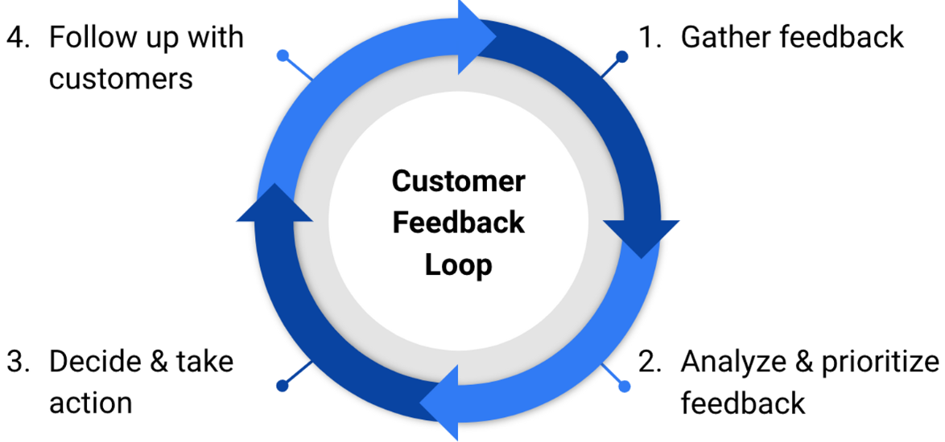
UNIT 3: Listen to customer feedback
SECTION 3.1.1: What is customer feedback?
Customer feedback must be a dynamic process!!!
Gather feedback
Analyse and prioritise feedback
Decide and take action
Follow up with customers
https://convas.io/blog/customer-feedback-loop

Slide 5
UNIT 3: Listen to customer feedback
SECTION 3.1.2: Why is listening important?
Why should we listen to customers?
Despite the fact that it is simply “polite” to listen to those who are investing in your business, there are sound business reasons for ACTIVELY listening to customer feedback:
Improve customer loyalty
Increase customer retention
Opportunities to cross-sell
Reduce customer loss
Showing customers they are important to you
https://blog.hubspot.com/service/listening-to-customers

Slide 6
UNIT 3: Listen to customer feedback
SECTION 3.1.3: Types of customer feedback
Customer feedback can be both verbalized (primary data) and non-verbalized (secondary data):
Verbalized feedback:
Comes in the form of direct and direct information collection from the customer
Customers ‘talk’ to us formally (survey, focus group) or informally (interactions with our customer-facing employees)
Non-verbalized feedback:
This can come through industry report; our own sales data
** CRITICAL: we need to do SOMETHING with the data collected otherwise it is irrelevant to us

Slide 7
UNIT 3: Show customers your are listening
SECTION 3.2.1: How to listen and act
How should we listen to customers?
Let them talk
Be patient, non-judgmental
Use their preferred channels of communication, not your own
Observe their behaviors and interactions in real situations
Focus on their problems, not just finding a solution to your problems
N.B.: what really counts is what customers are actually experiencing, not what issues we are facing (e.g., operational); focus on the accentuate the positive, deal with the negatives
https://blog.hubspot.com/service/listening-to-customers

Slide 8
UNIT 3: Show customers your are listening
SECTION 3.2.2: Feedback to customers after listening
It is critical to demonstrate to customers that you have listened to them! Otherwise, they can get discouraged and ambivalent towards you
Simply asking them information shows you are listening – at least it is a start
Make the changes they are looking for and/or explain why you cannot (close the feedback loop)
Reward customers when providing you with information
Follow up with a personalized “thank-you” message
Include them in social media posts or blogs
https://www.entrepreneur.com/article/250378

Slide 9
UNIT 3: Use tools to gain customer feedback
SECTION 3.3.1: Collecting information
It is critical to ask the appropriate questions.
Remember: garbage in, garbage out. Try to:
Use a reliable and tested measure (e.g., SERVQUAL) to gain customer feedback on what you want to measure
Avoid leading questions
Blend quantitative (numbers) with qualitative (words) to gain better insight
Take into account ethical considerations and General Data Protection Regulation (G.D.P.R.) when collecting data
** Avoid biases in analyzing data, no matter how it is collected; where possible gain some professional insight prior to collecting or analyzing data (avoid biases)

Slide 10
UNIT 3: Use tools to gain customer feedback
SECTION 3.3.2: Formal tools (primary data)
There are a number of tools that are available to collect data
1. Web-based: Some are freeware and others are ‘free’ up to a point. Some of the most commonly applied tools to collect data include:
Google Forms - SurveyMonkey - Microsoft Forms - Jotform
Cognito Forms - HubSpot Form Builder - Zoho Survey
2. “In-person” based:
Focus groups - Interviews - Observation

Slide 11
UNIT 3: Use tools to gain customer feedback
SECTION 3.3.3: Formal tools (raw / secondary data)
Raw or secondary data is also available to gain customer feedback. Some examples include:
Tracking customer sales over time:
in general across your customer base
for specific customers
Social media and blogs where customers and non-customers discuss issues related to our products / services
Industry level data that is publically available for analysis
Industry reports may be available, but many times are for a fee

Slide 12
Summing Up
Loop
Tools
Customer feedback is a loop that must be closed to be effective
Use the primary data tools available to collect reliable and valid data
Listening
Data
Feedback
Customers must be aware that we are listening and acting on their feedback
Use the data at hand (sales data) or publicly available to understand customers
Not a one-off process but an ongoing one

Slide 13
SWOT Analysis
SELF-EVALUATION
S
W
O
T
Strengths:
-
-
Weaknesses:
-
-
Opportunities:
-
-
Threats:
-
-

Slide 14
Key takeaways:
Takeaway 1: Customer feedback is essential for short and long term development of the organization
Takeaway 2: Businesses must listen to their customers and demonstrate that they are listening
Takeaway 3: Feedback can come from formal and informally as well as from primary and secondary sources
Takeaway 4: There are a number of readily available tools that can be used to collect data BUT the development of analysis of the data collected must be undertaken carefully

Slide 15
Thank-you!

